Slide 1
Gravity

Slide 2
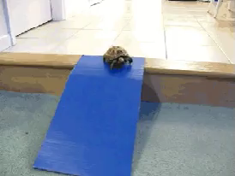
By the end of this lesson, you should be able to:
Explain how gravity relates to distance and mass.
Define the cosmological principle.

Slide 3
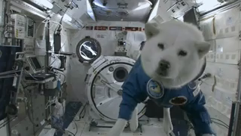
What keeps the universe together?
There are many different things in the universe - stars, planets, comets, galaxies and more - but what keeps it all together? The answer is gravity.
Gravity is the reason why we don't float off into outer space!

Slide 4
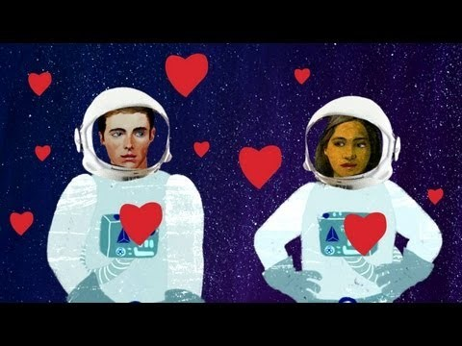

Slide 5
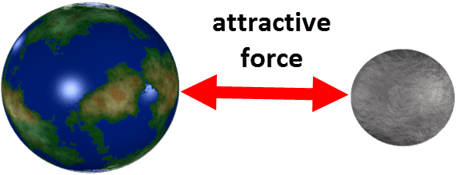
Everything that has a mass has a force field that attracts other masses.
This is known as a gravitational force field and the attractive force is called gravity.
Gravity makes objects move towards each other.

Slide 6
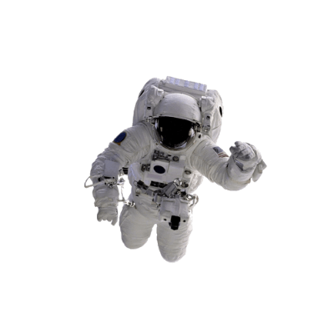
The strength of the gravitational force between two objects depends on two factors: the mass of an object and the distance between two objects.
Gravity is a force caused by mass: the bigger the mass, the stronger its gravitational field and the more it attracts other objects nearby.
Gravity is only noticeable when objects are really large like a planet, moon or stars. Everything has a gravitational field, but small things (like you) only have a very weak one.

Slide 7
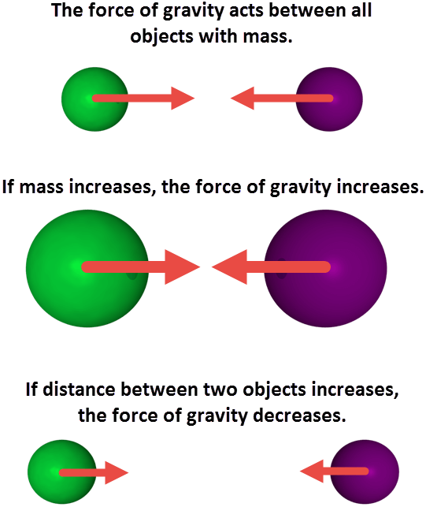
As the distance between objects increases, the gravitational field gets weaker.
The further you move away from Earth, the weaker the gravitational field.
This is why the Moon orbits the Earth, while Mars does not - the Moon is close enough to Earth to be affected by it.

Slide 8
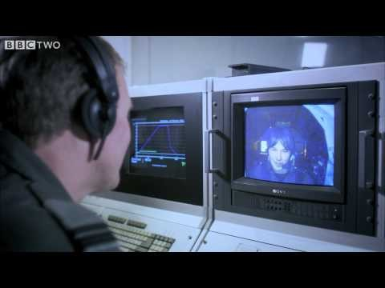

Slide 9
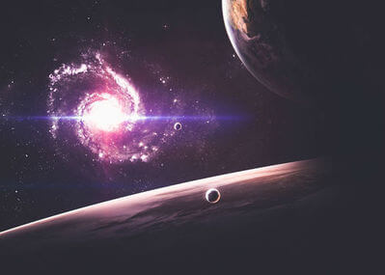
Outer space used to be poorly understood. It was assumed that it obeyed different laws to the Earth.
However, Newton's theory introduced a novel idea for science: that everywhere in the universe, space and Earth, follows the same laws.

Slide 10
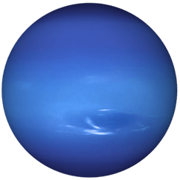
The Cosmological Principle is what we call the idea that every point of the universe obeys the same laws.
Gravity is one of those laws. Newton's theory could explain and predict the motion of the stars and planets, the Earth around the Sun, and the cycles of the Moon.
Alexis Bouvard, for example, used the theory to predict the existence of Neptune. He examined the orbit of Uranus and found inconsistencies with its motion that could be explained by an eighth planet.

Slide 11
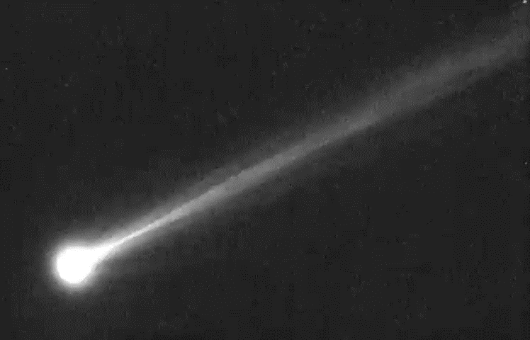
Edmund Halley was one of the astronomers who pushed Newton to publish his laws.
Halley then used those laws to predict the orbit of a comet around the Sun.
He predicted that it would return in 1758, and it did. This prediction was a powerful confirmation of the gravitational laws.

Slide 12
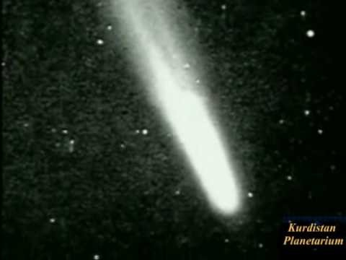

Slide 13
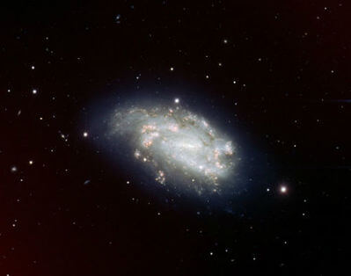
Every point of the universe has the same underlying principles and laws.
You see the same types of galaxies, stars and properties, no matter where you are.

